Slide 1
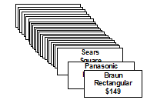
Full Profile Conjoint and Experimental Design
Introduction to full profile conjoint
With the full profile method of conjoint, respondents are presented with a set of entire product/service profiles. Preference ratings or rankings are obtained for each profile and this information is used to determine the part-worths of the attribute levels.
An advantage of this methodology is the realism provided by evaluations of entire product/service profiles.
Example:
Brand Loaf Shape Price
Oster Square $139
Braun Rectangular $149
Sears $159
Panasonic

Slide 2
Introduction to full profile conjoint
For the bread maker example there are 24 different profiles that are possible.
A respondent provided preference ratings for each profile using a scale from 0 (lowest preference) to 100 (highest preference). Results are provided below.

Slide 3
Introduction to full profile conjoint
Ordinary least squares regression (OLS) can be used to obtain the part-worth estimates. Note that effects coding is typically used in conjoint for the attributes. Data is in SPSS file FPC_BdMkr_full.sav

Slide 4
Introduction to full profile conjoint
Yhat = 54.50 + 11.83(Oster) + 8.17(Braun) + 3.83(Sears) + 6.08(Sqr) + 8.50($139) + 3.25($149)
What are the importance measures for brand, shape, and price?

Slide 5
Note that these results match our regression results.
How to interpret the Importance scores ?

Slide 6
Relative Attribute Importance
In general, importance measures for attributes are obtained from the utility ranges. The general formulation for attribute importances for conjoint is as follows:
Importance of Attribute a =
(part worth range for Attribute a)/ (sum of the part-worth ranges for all attributes)

Slide 7
Experimental Design for Conjoint
Good designs help produce “Good” (Precise) utility estimates (small standard errors).
In statistical terms we want our designs to be efficient
D-Efficiency is an overall measure of design efficiency that ranges from 0 to 100. It is based on the average size of the utility standard errors
100% D-efficient designs are both balanced and orthogonal (for a given sample size, will produce the most precise utility estimates (smallest standard errors).
-Balance- A design is balanced if for all factors, the corresponding levels appear with the same frequency.
-Orthogonal- For an orthogonal design, all factors are uncorrelated.

Slide 9
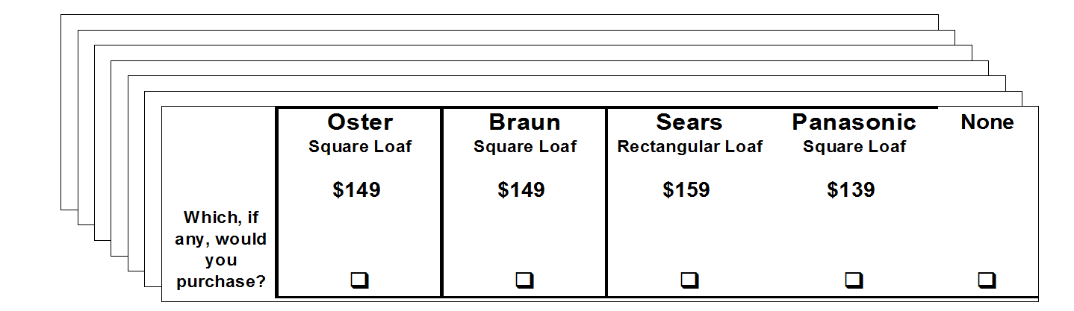
Discrete Choice
Discrete Choice (also referred to as Choice Based Conjoint) has a respondent task where choices are made among sets or profiles, rather than having respondent rate/rank profiles.

Slide 11
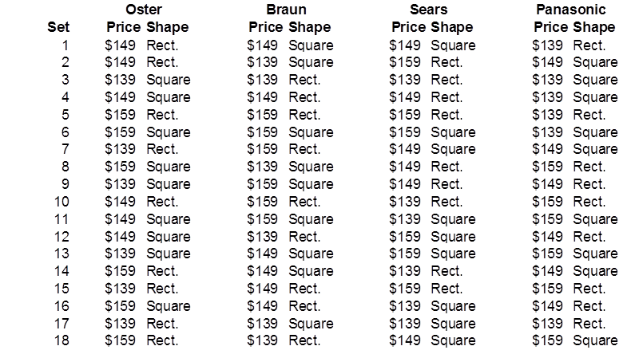
Assigning labels to the resulting design produces the following:

Slide 13
Discrete Choice Market Simulators
As with conjoint, discrete choice simulators facilitate the determination of share estimates for user supplied scenarios.
Features include base case comparisons, product optimizations, and sensitivity analyses.
With individual level utilities, share estimates can be obtained by performing the logit probability calculation for each individual, and averaging the resulting probabilities across respondents.
For our bread maker example (excel file “BreadMaker_CBC.HB.example_simulator.xlsx”)

Slide 14
HB Choice Simulator Share Calculation Illustration

Slide 15
Added Application 2)
A discrete choice pricing study for canned baked beans was conducted that involved two brands, Bush and Campbell’s, along with a none/other alternative. Only price varied for the two brands. The experiment included 3 prices; $.89, $.99, $1.09.
A sample of 1000 respondents was employed where each respondent made choices for each of the 9 scenarios. Estimation was employed and the utilities are provided in file Topic4_added.app.2.data.xlsx. Using the methods covered in class, estimate share if Bush is priced at $0.89 and Campbell’s is priced at $.99.

Slide 16
5) Factor Analysis (with Key Driver Application)

Slide 17
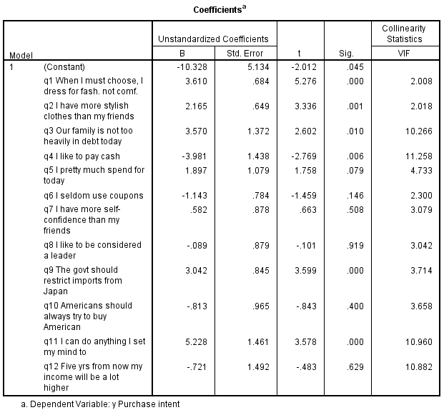
A multiple regression with purchase intent as the dependent variable produced the following.

Slide 18
There are different types of factor analysis. We will cover the common approach used in marketing called Principal Components Factor Analysis
Solve for the linear equations such that the first factor explains as much of the data variation as possible, the second factor explains as much of the remaining variation as possible while being uncorrelated with the first factor, etc.
There will be as many factors as X variables. However, some factors may not be very informative and may be dropped.

Slide 19
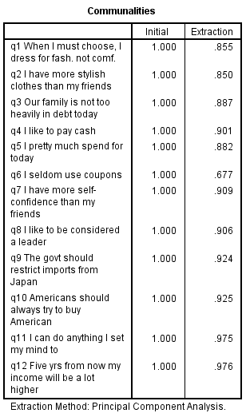
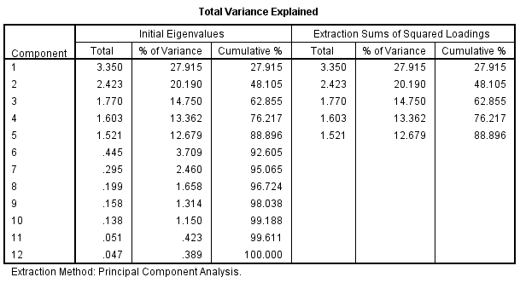
For our example:

Slide 20
The appropriate number of factors can be determined by
-Prior knowledge
-Eigenvalues- There is an eigenvalue associated with each factor. The eigenvalue indicates the total
amount of variance attributed to the associated factor. The total amount of variance in the data is given by the sum of all the eigenvalues– which equals the number of variables (since we are dealing with standardized variables, the variance of any one variable = 1)The general rule is to retain only those factors with eigenvalues > 1.
-Cumulative percentage of variance
Communalities- The proportion of the variance of each variable that is explained by the selected factors

Slide 22
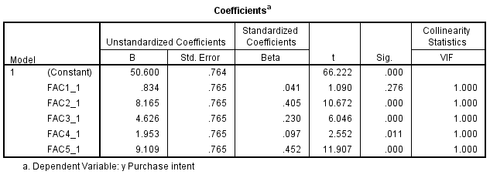
Using the factors as explanatory variables in our regression application produces the following:

Slide 23
6) Perceptual Mapping Procedures

Slide 24
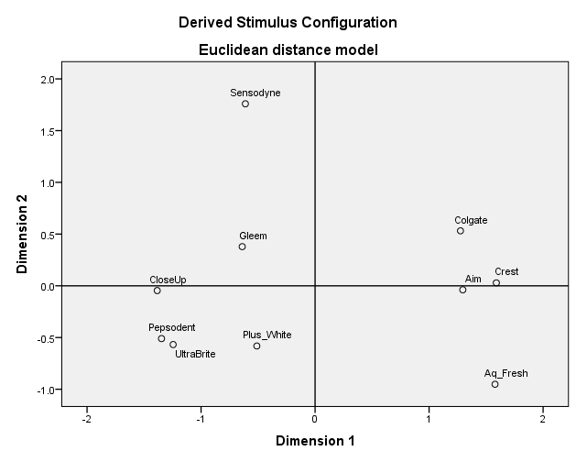
Similarity Map

Slide 25
Attributes Based Map

Slide 26
7) Cluster Analysis
There are a large variety of cluster analysis methods. Similarity based methods obtain solutions using measures of similarity between objects for specified variable sets (basis variables). A variety of alternative algorithms are used to arrive at specific cluster solutions based on the similarity measures employed. We will cover hierarchical clustering and nonhierarchical (k-means) similarity based clustering methods.
The basic analysis steps typically consist of :
Selection of basis variables and data prep.
Selection of similarity measure and clustering algorithm
Determination of the number of clusters
Interpretation and validation

Slide 27
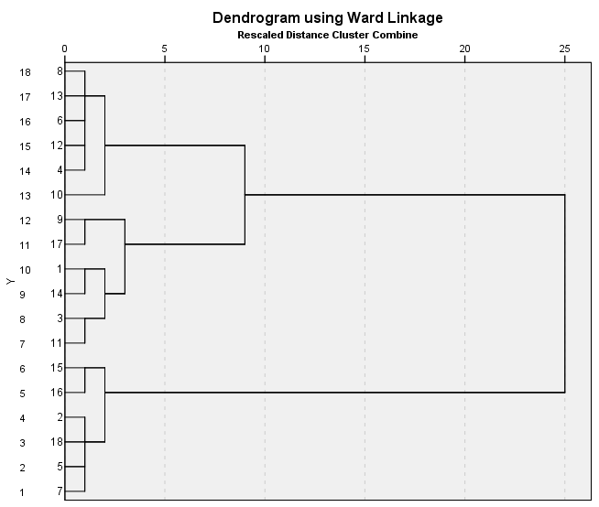

Slide 28
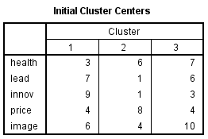
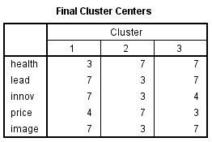
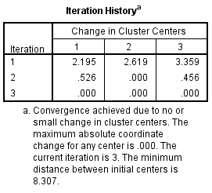
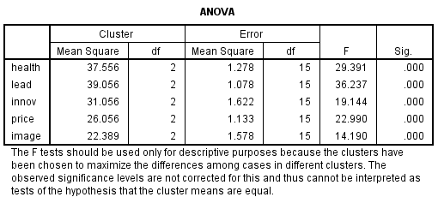
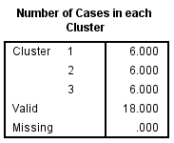
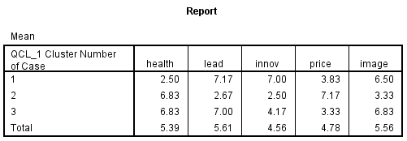
Applying K-means to the beverage data
Click Analyze, Classify, K-means cluster
After entering variables select 3 for Number of clusters
Click Options and select ANOVA table
Click Save and select Cluster membership, click Continue, then Ok

